Slide 1
GAN based anomaly detection
KAMP: vibration and current dataset in welding
2023.11.28
Notes:
Hello, we are team (). And I’d like to present about our this week’s progress of final project.

Slide 2
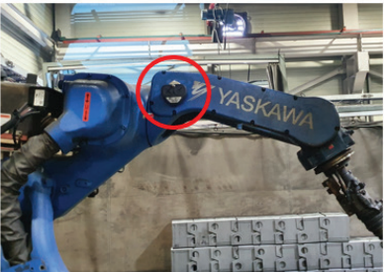
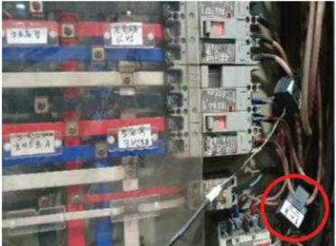
▣ Project proposal
Welding manufacturing
Project proposal
Vibration and current datasets (Normal / Abnormal)
Model selection
Model training based on normal data
Set MAE threshold to detect abnormal operation
Model validation
Notes:
First, the shape of the model that has a problem in actual operation is as follows. You can see that the motor case is connected with the main frame with two point contacts.
And the calculated tension that we have to consider is about 700 N. And generally, considering some coefficients, the maximum tension we got is about 5 kN.
And the main problem of this structure was chain loosening and um,, some cases that seem to be a material yield in some frames of the rear part.
So we planned to make some developments to solve those problems by getting proper analysis of this model.

Slide 3
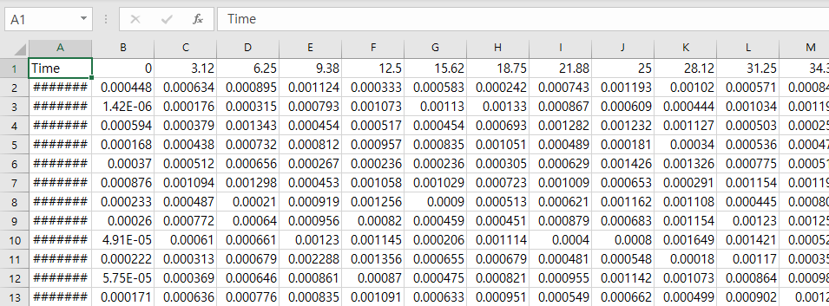
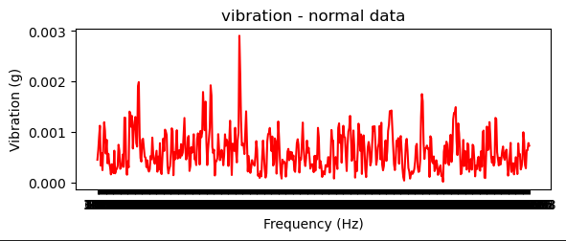
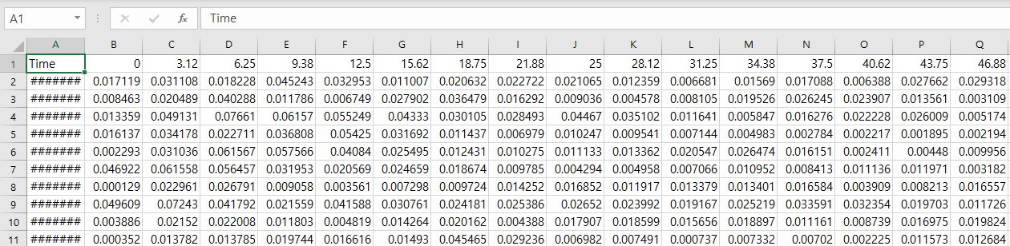
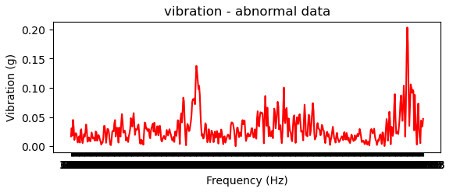
▣ Project proposal
Data analysis (Vibration)
Dataset
: Signal in frequency domain
First raw : frequency [Hz]
First column : measurement time data
[Vibration normal dataset : $1774×512$]
[Vibration normal dataset]
[Vibration abnormal dataset : $16×512$]
[Vibration abnormal dataset]

Slide 4
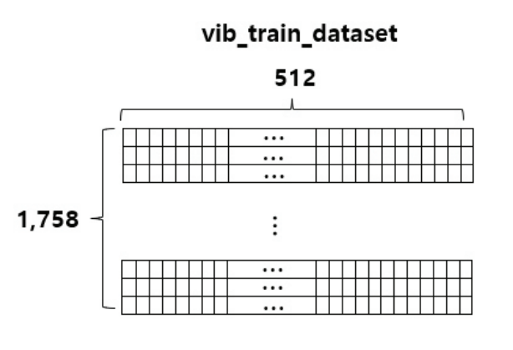
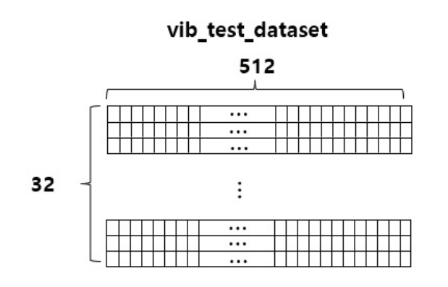
▣ Data processing
Preprocessing
Raw data format
Vibration normal
1774 x 512 size
Vibration abnormal
Data split
16 x 512 size

Slide 5
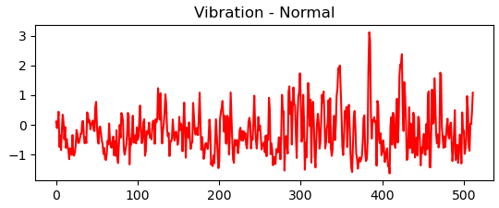
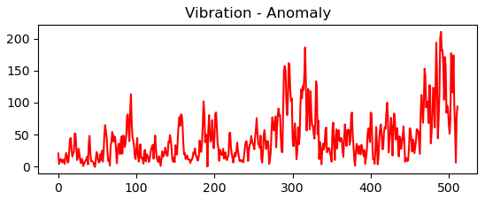

▣ Data processing
Data standardization
$$x^{′}=\frac{x−μ}{σ}$$
[Vibration normal dataset]
[Standardized train dataset]
[Vibration abnormal dataset]
[Standardized dataset]

Slide 6
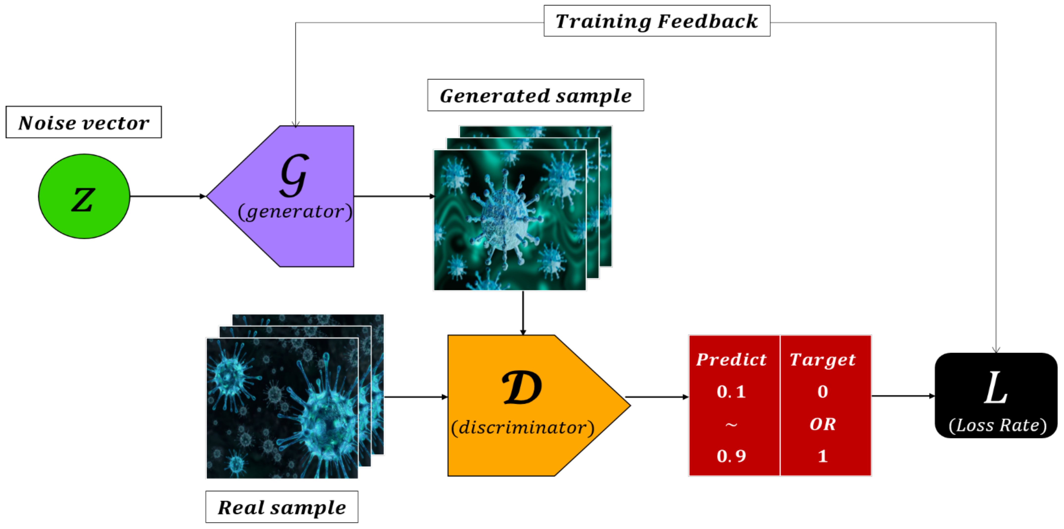
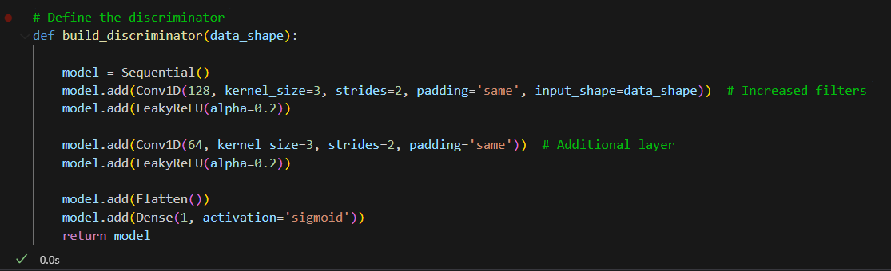
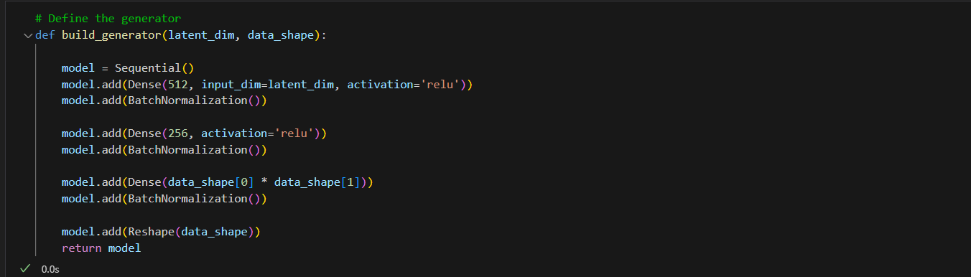
▣ Training
Generative Adversarial Networks (GAN)
[Structure of GAN model]
[Structure of discriminator]
Considering the difference between convolutional autoencoder
Input noise factor to the generator
Reconstruct the original train signal with repetitive training
Generator: sequential structure (dense & batch normalization layer)
Discriminator: flatten & sigmoid binary classification
[Structure of generator]

Slide 7
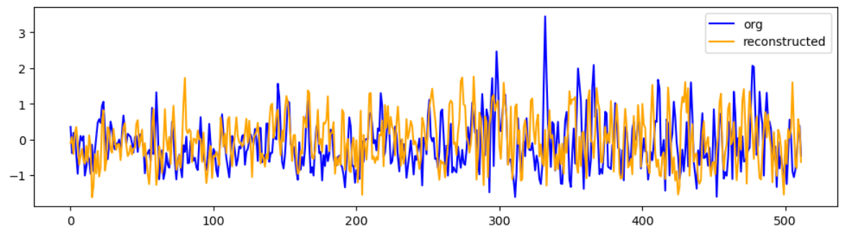
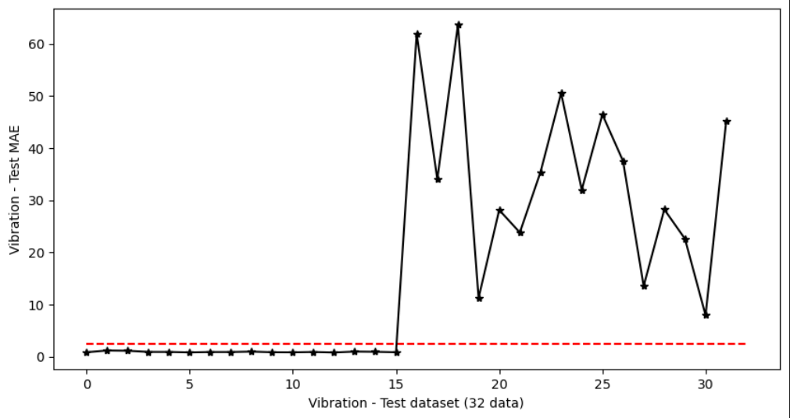
▣ Model validation
Detection performance
vib_train_mae = abs(org_sig – reconstructerd_sig).mean()
Threshold = mean(vib_train_mae) + std(vib_train_mae)
Abnormal vibration signal detection
[original and reconstructed signal : vibration train set]
: Vibration abnormal signal
Have a positive effect in anomaly detection
[original and reconstructed signal : vibration test set]

